Slide 1

Green Pace
Security Policy Presentation
Developer: Austin Donaubauer

Slide 2

OVERVIEW: DEFENSE IN DEPTH
Green Pace requires consistent implementation of secure principles, like defense in depth, to all developed applications. Defense in depth shown below lists the layers that the security policy will focus on

Slide 3
THREATS MATRIX
Likely STD-002-CPP – Do not read uninitialized memory STD-003-CPP – Do not attempt to create a std::string from a null pointer STD-004-CPP – Prevent SQL Injection STD-005-CPP – Do not access freed memory STD-007-CPP – Do not abruptly terminate the program | Priority STD-002-CPP – Do not read uninitialized memory STD-003-CPP – Do not attempt to create a std::string from a null pointer STD-004-CPP – Prevent SQL Injection
Low priority STD-001-CPP – Obey the one-definition rule STD-005-CPP – Do not access freed memory STD-006-CPP – Use a static assertion to test the value of constant expression STD-007-CPP – Do not abruptly terminate the program STD-008-CPP – Do not use pointer-to-member operators to access nonexistent members STD-009-CPP – Do not cast to an out-of-range enumeration value STD-010-CPP – Close files when they are no longer needed | Unlikely STD-001-CPP – Obey the one-definition rule STD-006-CPP – Use a static assertion to test the value of constant expression STD-008-CPP – Do not use pointer-to-member operators to access nonexistent members STD-009-CPP – Do not cast to an out-of-range enumeration value STD-010-CPP – Close files when they are no longer needed
Ranking of the coding standards based on likeliness and priority. Likeliness indicates how often it should be looked for. Priority indicates the level to which the threat should be fixed.

Slide 4
10 PRINCIPLES
Validate Input Data –
STD-002-CPP – Do not read uninitialized memory
STD-004-CPP – Prevent SQL Injection
STD-007-CPP – Do not abruptly terminate the program
STD-009-CPP – Do not cast to an out-of-range enumeration value
Heed Compiler Warnings –
STD-001-CPP – Obey the one-definition rule
STD-002-CPP – Do not read uninitialized memory
STD-003-CPP – Do not attempt to create a std::string from a null pointer
STD-005-CPP – Do not access freed memory
STD-007-CPP – Do not abruptly terminate the program
STD-009-CPP – Do not cast to an out-of-range enumeration value
Architect and Design for Security Policies –
Keep it Simple –
STD-001-CPP – Obey the one-definition rule
STD-002-CPP – Do not read uninitialized memory
STD-004-CPP – Prevent SQL Injection
STD-007-CPP – Do not abruptly terminate the program
Default Deny –
STD-004-CPP – Prevent SQL Injection
STD-005-CPP – Do not access freed memory
STD-010-CPP – Close files when they are no longer needed
Adhere to the Principle of Least Privilege -
STD-004-CPP – Prevent SQL Injection
STD-010-CPP – Close files when they are no longer needed
Sanitize Data Sent to Other Systems –
STD-004-CPP – Prevent SQL Injection
STD-007-CPP – Do not abruptly terminate the program
Practice Defense in Depth –
STD-004-CPP – Prevent SQL Injection
STD-010-CPP – Close files when they are no longer needed
Use Effective Quality Assurance Techniques –
STD-004-CPP – Prevent SQL Injection
STD-006-CPP – Use a static assertion to test the value of constant expression
STD-007-CPP – Do not abruptly terminate the program
STD-008-CPP – Do not use pointer-to-member operators to access nonexistent members
Adopt a Secure Coding Standard –
STD-001-CPP – Obey the one-definition rule
STD-002-CPP – Do not read uninitialized memory
STD-003-CPP – Do not attempt to create a std::string from a null pointer
STD-004-CPP – Prevent SQL Injection
STD-005-CPP – Do not access freed memory
STD-006-CPP – Use a static assertion to test the value of constant expression
STD-007-CPP – Do not abruptly terminate the program
STD-008-CPP – Do not use pointer-to-member operators to access nonexistent members

Slide 5
CODING STANDARDS
Listing the standards in priority order is important so that developers know how they need to follow each standard.
Priority can be based on how much damage an attack can deal.
Something like an SQL injection can cripple a system if its not prevented
1. STD-004-CPP – Prevent SQL Injection
2. STD-002-CPP – Do not read uninitialized memory
3. STD-003-CPP – Do not attempt to create a std::string from a null pointer
4. STD-001-CPP – Obey the one-definition rule
5. STD-005-CPP – Do not access freed memory
6. STD-006-CPP – Use a static assertion to test the value of constant expression
7. STD-007-CPP – Do not abruptly terminate the program
8. STD-008-CPP – Do not use pointer-to-member operators to access nonexistent members
9. STD-009-CPP – Do not cast to an out-of-range enumeration value
10. STD-010-CPP – Close files when they are no longer needed

Slide 6
ENCRYPTION POLICIES
Encryption at rest – Data is at rest when it is stored on a hard drive or database. Encrypting this data is important because this data is often the most important for programs. This is often the most valuable data hackers can get, which is why it needs to be secured and encrypted.
Encryption in flight – Data in flight is when it is being transmitted from one computer to another, or across a network. Because it is in transit it makes the data susceptible to interception attacks and gets stolen. To protect data in transit the data needs to be encrypted by a secure algorithm and only accessible with a key that will unencrypt it.
Encryption in use – Data in use is what the data is actively being viewed or used on the program. Encrypting this data means making sure the data is only accessible by those with the correct permissions to access it. Using the lease privileges that a user needs will protect the data from unwanted access if users are attacked.

Slide 7
TRIPLE-A POLICIES
Authentication – Proper authentication will protect users from attacks. Using multifactor authentication and other protocols like CAPTACHA will prevent unauthenticated access and protect data.
Authorization – Only allowing the least privileges to users will make sure only certain data is accessed by users. This helps prevent data lost if a user is attacked and accessed by a hacker.
Accounting – Logging user activity to monitor for unusual activity is a keyway to be secure. Finding unusual activity can lead to a quicker response time to attacks which will hopefully prevent the least amount of data lost by any attacks.

Slide 8
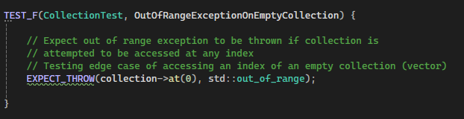
Unit Testing – Exception Out of Range
Exception testing for out of range access of a collection
The test was successful

Slide 9
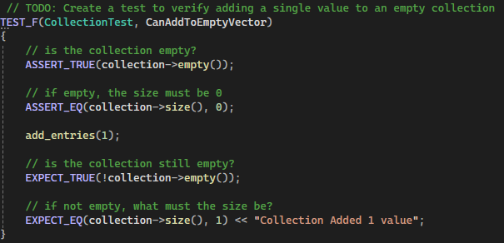
Unit Testing – Add to empty vector
Testing to add an entry to an empty vector
The test was successful

Slide 10
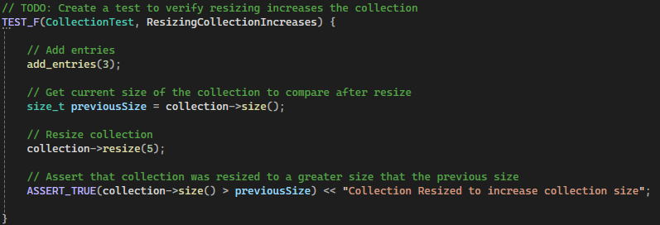
Unit Testing – Testing ability to resize the vector
Testing ability to resize a vector
The test was successful

Slide 11
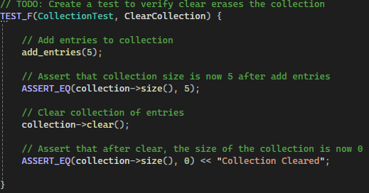
Unit Testing – Clear entries from a vector
Testing ability to clear entries from a vector
The test was successful

Slide 12

AUTOMATION SUMMARY

Slide 13
TOOLS
Adding automation for security to create the DevSecOps process is important. The need to integrate security is to ensure security is included in each phase. Automating will help efficiently add security to each phase and prevent issues later in the cycle. During the Design phase there will now be integrated tools into the IDE’s to automate the policies. Tools like Coverity, Klocwork, Clang, and others will scan code now during each new iteration of the code to find vulnerabilities and errors so the developer can fix it right away. For the Building and Test phases, the continued use of static application security testing tools like Coverity will be part of the acceptance criteria. Testing tools will scan the builds as they are submitted. Testing will include unit tests to help test values and find undesired behavior.
For the production phases, continuous monitoring and analysis will be key. Policies like deny default and least privileges will be a layer of the defense in depth approach. We will also use the logging and monitoring to ensure activity is monitored. Finding unusual activity will help us respond fast and be more efficient in resolving issues.

Slide 14
RISKS AND BENEFITS
Putting a Security Policy in place that utilizes a practice like Don’t leave security until the end
puts security into each step of the development. This has many benefits like it makes the
process more efficient. Having programmers that keep security in mind lets them code more
securily and lets them plan for attacks like an SQL injection which can help prevent that attack
from being successful and causing financial loss.
Waiting to implement security at the end can cause delays to the schedule. It could mean the
product would be less secure as coders may not think about security while developing which
could allow vulnerabilities to exists.

Slide 15
RECOMMENDATIONS
We need to implement the IDE tools that could integrate the coding standards into the code. Using IDE plug-ins will be beneficial to enforcing the coding standards so no standards are violated.
Provide proper training and documentation to the team for the new security policy so that everyone is ready and aware
Creating projects and adding them to GitHub responsitories will assist the team with collaboration on each branch and allow Project team members to review updates as they are pushed

Slide 16
CONCLUSIONS
Using the tools like cppcheck and others can help coders implement the coding standards correctly
Implementing defense in depth such as adhering to the principle of least priveledge is a major are to be aware of and can help protect the system
Using an algorithm to encrypt and decrypt data will help protect the data as well. This would be an example of the policy to Encrypt data at rest.

Slide 17
REFERENCES
Rule 01. declarations and initialization (DCL). Rule 01. Declarations and Initialization (DCL) - SEI CERT C++ Coding Standard - Confluence. (n.d.). https://wiki.sei.cmu.edu/confluence/pages/viewpage.action?pageId=88046322

